Slide 1

Bank Customer Churn Prediction

Slide 2
What is Bank Customer Churn Prediction?
Customer Churn prediction means knowing which customers are likely to leave or unsubscribe from your service.
Process of identifying customers who are likely to leave a bank. This can be done by analyzing customer data, such as account activity, demographics, and product usage. Banks can use this information to target customers with retention efforts, such as special offers or discounts
Problem Statement: Banks can develop accurate customer churn prediction models that can be used to identify customers who are at risk of churning and to target them with retention efforts. This can help banks to reduce customer churn and improve customer satisfaction.
Factors that contribute to bank customer churn
Uncompetitive pricing
Poor customer service
Unattractive products and services
Competition from other Banks
Personal reasons

Slide 3
Introduction
The project aims to develop a Bank Customer Churn Prediction system using machine learning techniques. Customer churn refers to the phenomenon where customers terminate their relationship with a bank, which can have significant financial implications for the bank. By accurately predicting customer churn, banks can proactively take measures to retain valuable customers and minimize revenue loss.
Objectives:
Data Collection and Preparation
Feature Engineering
Model Selection
Model Training and Validation
Monitoring and Maintenance
The ultimate goal of the project is to provide the bank with an accurate and reliable churn prediction system that can assist in proactive customer retention efforts, thereby improving customer satisfaction and reducing revenue loss associated with customer churn.

Slide 4
Data Description:
The data description for the bank customer churn prediction dataset:
Feature and description:
Customer_id - Unique identifier for each customer
Surname—the surname of a customer has no impact on their decision
RowNumber—corresponds to the record (row) number and has no effect on the output
CreditScore—can have an effect on customer churn, since a customer with a higher credit score is less likely to leave the bank
Geography—a customer’s location can affect their decision
Gender-Customer's gender
Age--Customer's age
Tenure -Number of years that the customer has been with the bank
Balance-Customer's account balance
Products_number-Number of products that the customer has with the bank
credit_card -Whether or not the customer has a credit card with the bank
active_member-Whether or not the customer is an active member of the bank's rewards program
estimated_salary - Customer's estimated salary
Exited—whether or not the customer left the bank.

Slide 5
Machine Learning algorithm for customer churn prediction will depend on the specific data set and the desired accuracy. However, logistic regression, decision trees, random forests, and support vector machines are all effective algorithms that can be used for this task.
The data is split into two sets: a training set and a test set. The training set is used to train the customer churn prediction model. The test set is used to evaluate the accuracy of the model.
The customer churn prediction model can be used to identify customers who are at risk of churning. This information can be used to target customers with retention efforts.

Slide 6
Exploratory Data Analysis
Exploratory Data Analysis is a crucial step in data analysis that aims to understand the main characteristics, patterns, and insights within a dataset. It involves a variety of techniques and visualizations to explore the data and gain preliminary insights before proceeding with further analysis or modeling.
They are three parts of EDA techniques :
Univariate analysis : Is a statistical method that involves analyzing a single variable. This type of analysis is often used to describe the distribution of data, identify patterns, and test hypotheses
Bivariate analysis : Is a statistical method that involves analyzing two variables. This type of analysis is often used to measure the relationship between two variables, such as the relationship between customer satisfaction and customer churn.
Multivariate analysis : Is a statistical method that involves analyzing multiple variables. This type of analysis is often used to identify patterns and relationships between variables, and to make predictions

Slide 7
Univariate analysis
The involves examining the distribution of a single variable.This can be done using a variety of techniques, such as
histograms , boxplots ,
Histograms: Histograms are a graphical representation of the distribution of data. They can be used to see how the data is spread out and to identify any unusual patterns.
Boxplots: Boxplots are a graphical representation of the distribution of data that includes the median, quartiles, and outliers. They can be used to see how the data is spread out and to identify any unusual patterns.

Slide 8
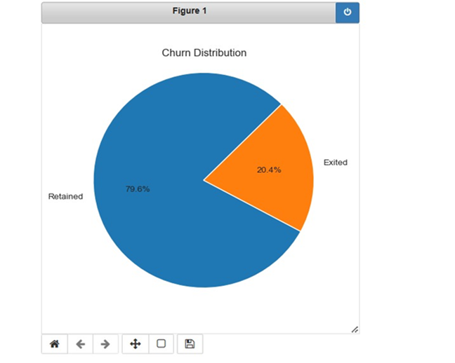
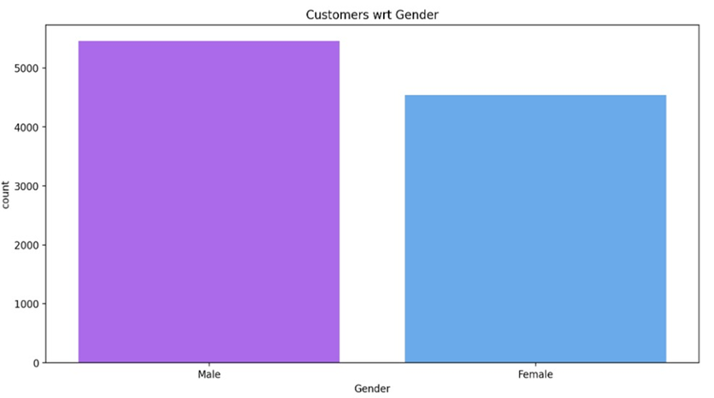
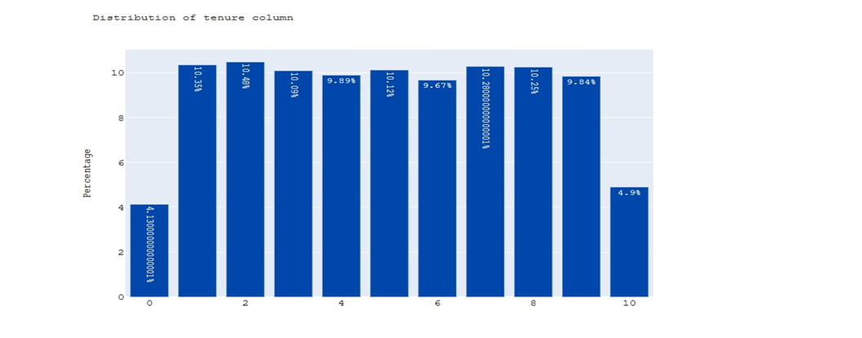
This graph represents custermor’s in company were Churn distributed.
This graph shows the population of male and female in bank
This graph shows the how many years customers still there in bank

Slide 9
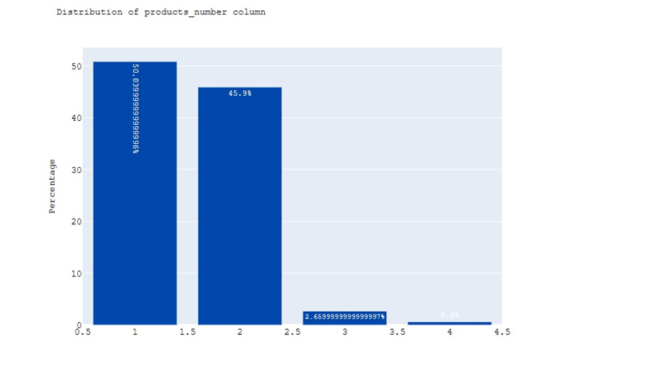
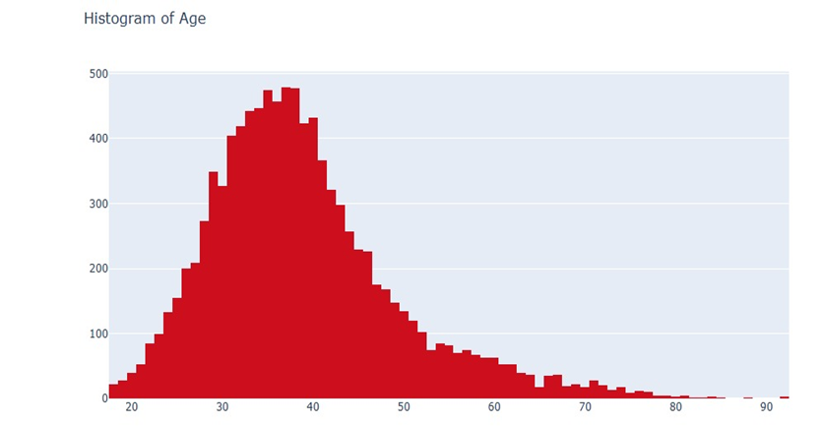
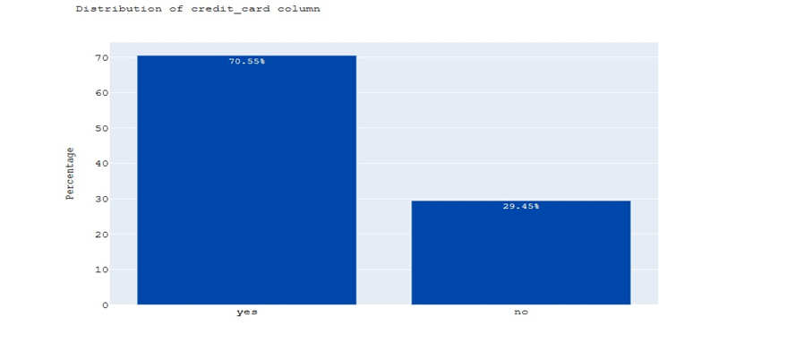
This graph shows number of products that the customer has with the bank
This histogram shows there are more customer’s are from 30-50 age group
This graph shows whether yes or no the customer has a credit card with the bank.

Slide 10
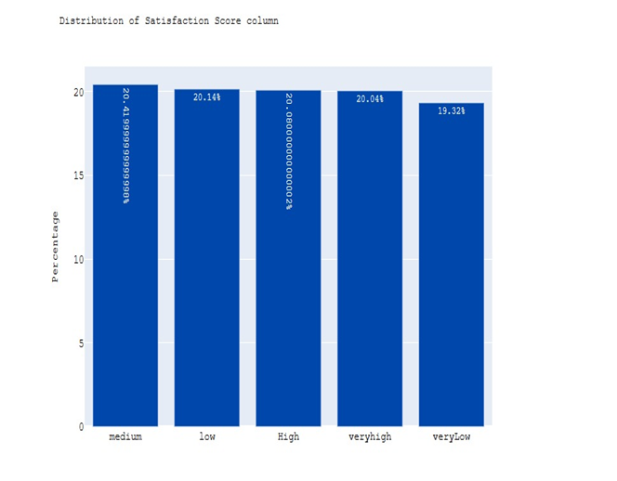
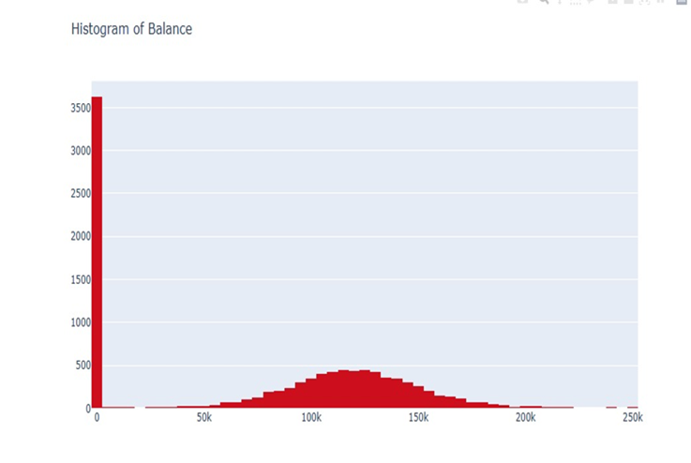
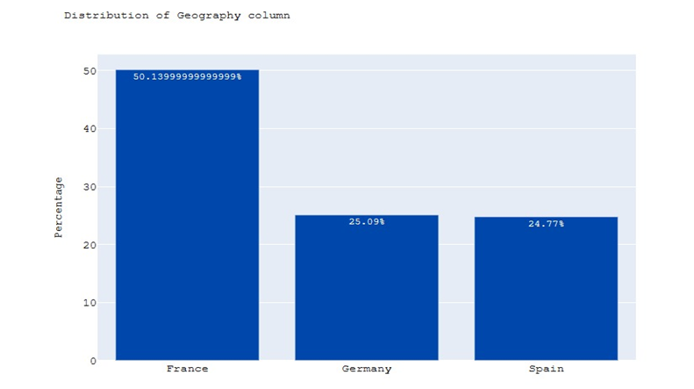
This graph shows that how many customers having balance accounts in bank
This graph shows that the percentage of medium level as more satisfaction score
This graph shows that the France is having more population as bank customers

Slide 11
Bivareiant:
Geography and churn -Germany stands out in terms of having a relatively higher count of churned customers.
Churn by gender -It appears that the churn rate is relatively similar across both genders.
Churn by age group -Customers aged between 50-60 tend to churn the most, followed by the 40-50 age group.
Number of products and churn-The number of products held by customers can impact churn. Customers with fewer products may be less likely to churn, while those with more products may have a higher churn rate. Further analysis is required to understand the specific relationship.

Slide 12
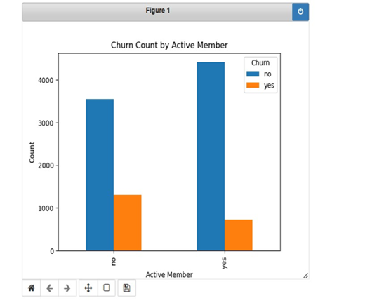
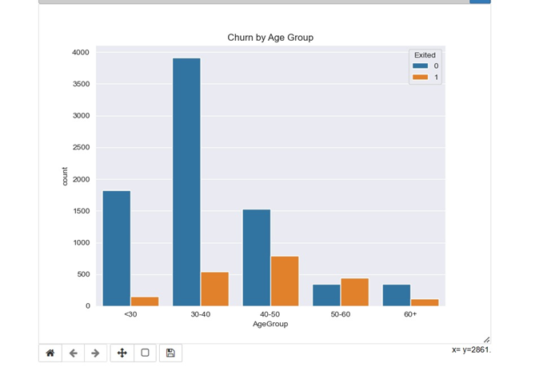
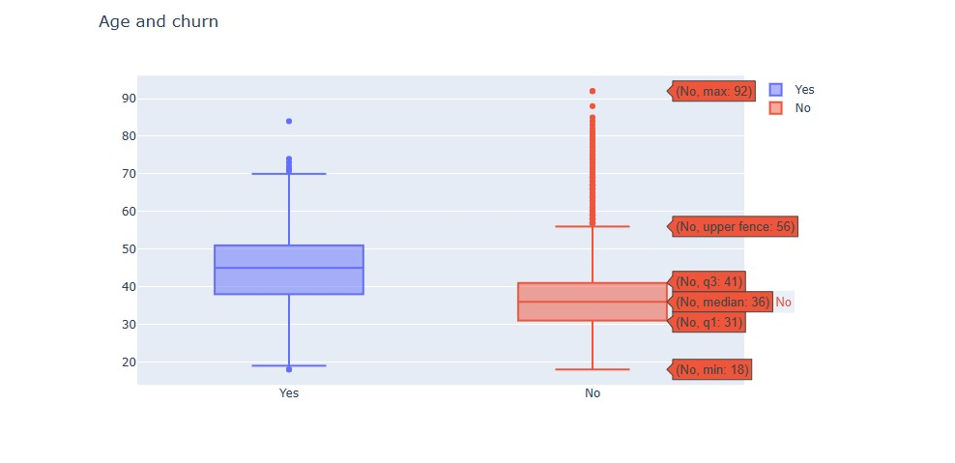
When customers are not active , then there is a chance of churn
Customers between the age group of 40 -60 are more likely to churn
Age group between 40 to 50 are exited or churned compare to age between 30 to 40

Slide 13
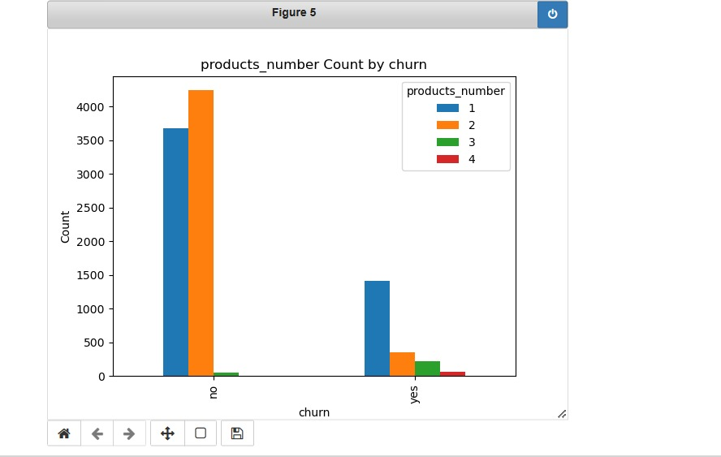
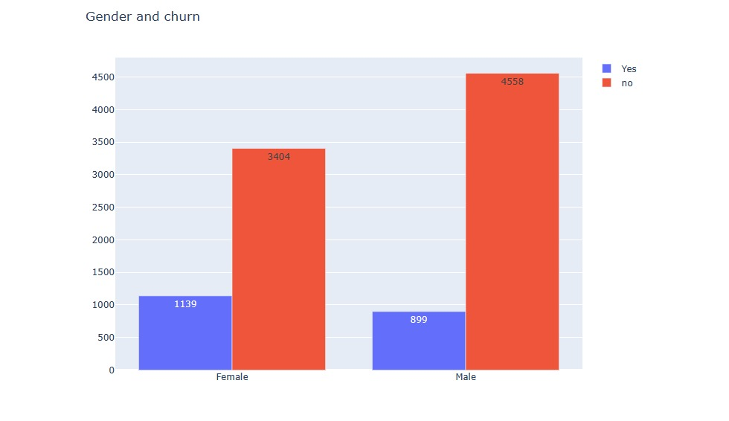
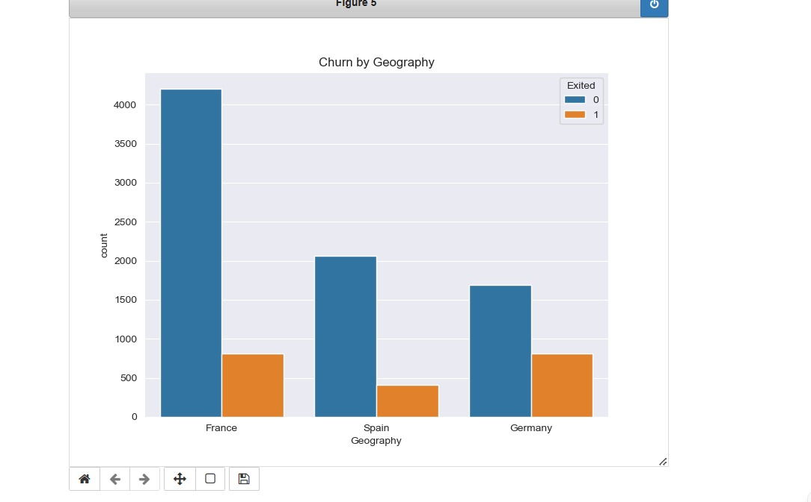
Customers having products more than 2 are more likely to churn
There is not much difference in female and men churn counts
Germany is having more exited or churned customers

Slide 14
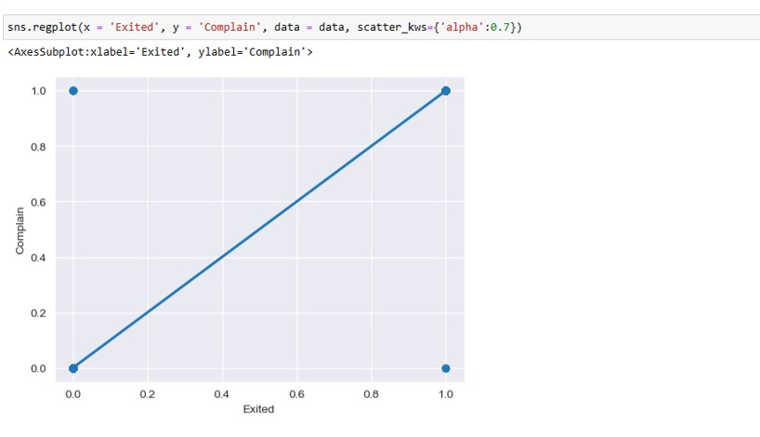
Complain variable is directly proportional to the churn . so we can say that complain is crucial column but it is also overshadowing the other columns hence we can say that complain is a suspicious column

Slide 15
Multivarient:
Multivariate analysis is a statistical method that analyzes multiple variables simultaneously. It is used to identify relationships between variables and to make predictions about future outcomes. Multivariate analysis can be used in a variety of fields, including business, finance,medicine,and social science.

Slide 16
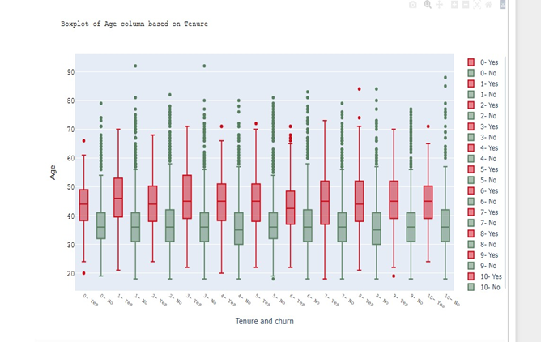
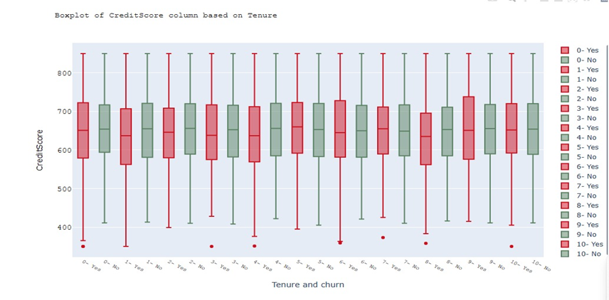
Customers having age between 40 to 50 and having tenure more than 6 years are more likely to churn or exited from bank.
Customers having credit score less than 350 are more likely to get churn or exited even if there tenure is more than 5 years and so on

Slide 17
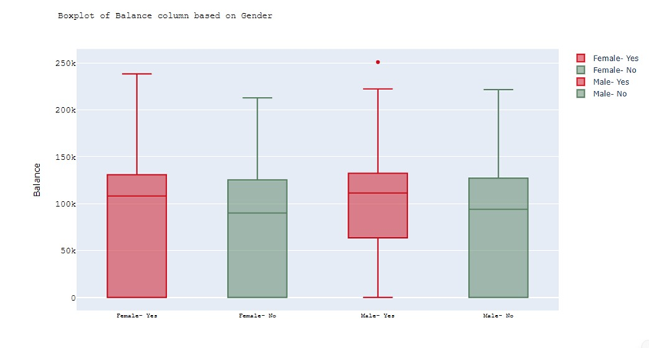
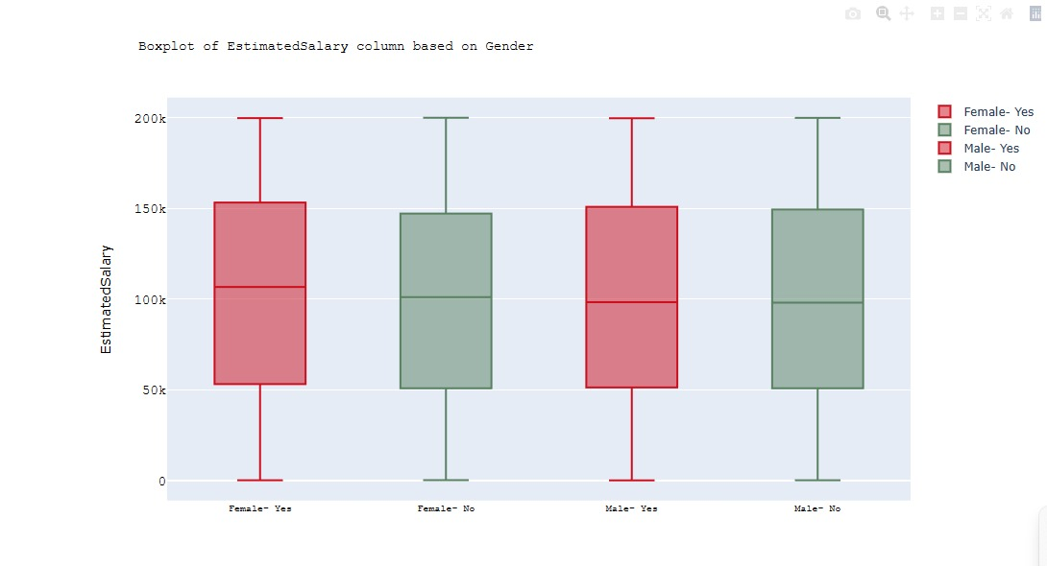
Point earned by customers doesn't show any specific variance in churn data with respect to gender
Estimated salary doesn't have any impact on churn

Slide 18

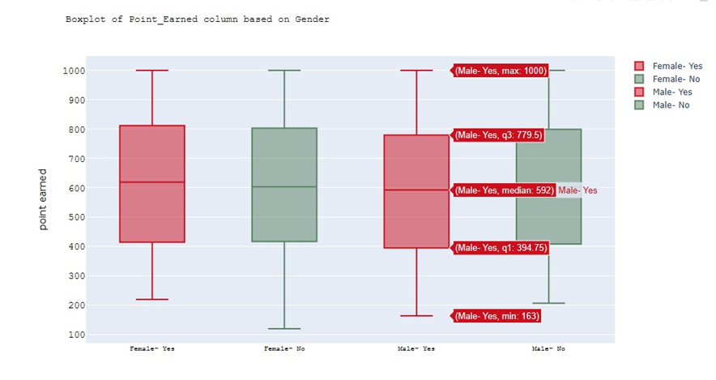

Slide 19
Summary:
we can conclude that balance plays a very important role in deciding the churn of the employee.
Apart from that, complain, Satisfactionscore, numofproducts,isactivemember also are among the top contributors.
On the other hand, factors such as pointEarned, Gender, cardtype,Estimatedsalary,hascredit card,surname tend not to contribute as significantly
Bank can focus on variables that contribute significantly in determining if customer is exited from the bank. Such variables are:
geography
age
balance
numofproducts
complain
satisfactionscore
creditscore
isactivemember
The customers are more concerned with the services of the bank.
Then comes the psychological variables that determines if a customer might leave the bank.
Hence, the bank can focus on such aspects and understand from the viewpoint of the customer.
Once that is followed, churn project can be used as a Retention project. This can immensely help the organization.
Secondly, the model needs to be tuned from time to time as and when new dataset is received.
In case any new input variable is introduced, it is important that the information is retrieved for the customer who participated in the initial study.

Slide 20


